Slide 1

SPM Software & Resources
Wellcome Trust Centre for Neuroimaging
University College London
SPM Course
London, May 2011

Slide 2
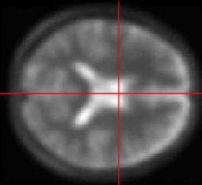
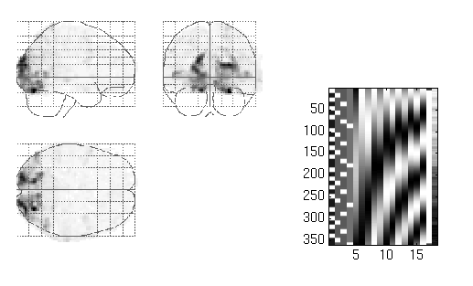
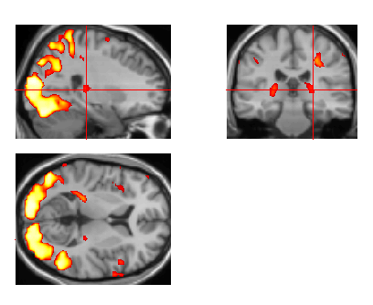
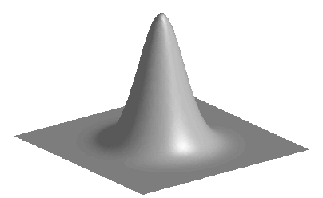
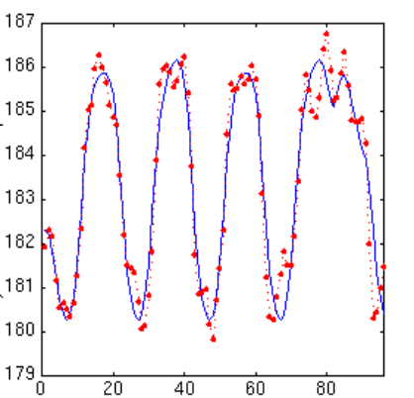
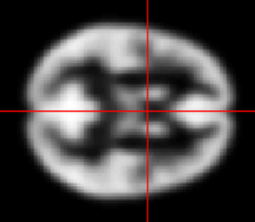
Image time-series
Spatial filter
Design matrix
Statistical Parametric Map
Realignment
Smoothing
General Linear Model
Statistical
Inference
RFT
Normalisation
Anatomical
reference
p <0.05
Parameter estimates

Slide 3
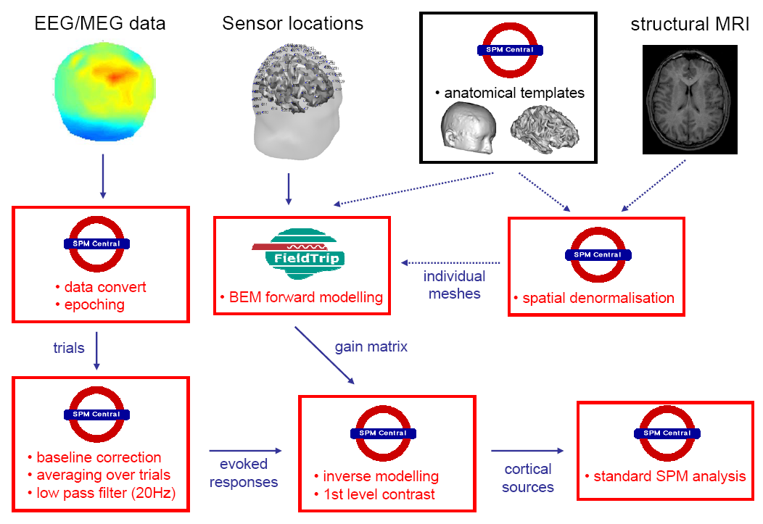


Slide 4




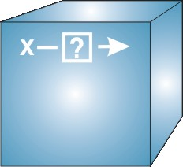
Software: SPM8
Open Source academic freeware (under GPL)
Documented and informally supported
Requirements:
  MATLAB: 7.1 (R14SP3) to 7.10 (R2010a)
  no Mathworks toolboxes required
  Supported platforms (MEX files):
  File Formats:
    Images: NIfTI-1 (& Analyze, DICOM)
    Surface meshes: GIfTI
    M/EEG: most manufacturers (with FieldTrip’s fileio)
Linux (32 and 64 bit)
Windows (32 and 64 bit)
Mac Intel (32 and 64 bit)

Slide 5
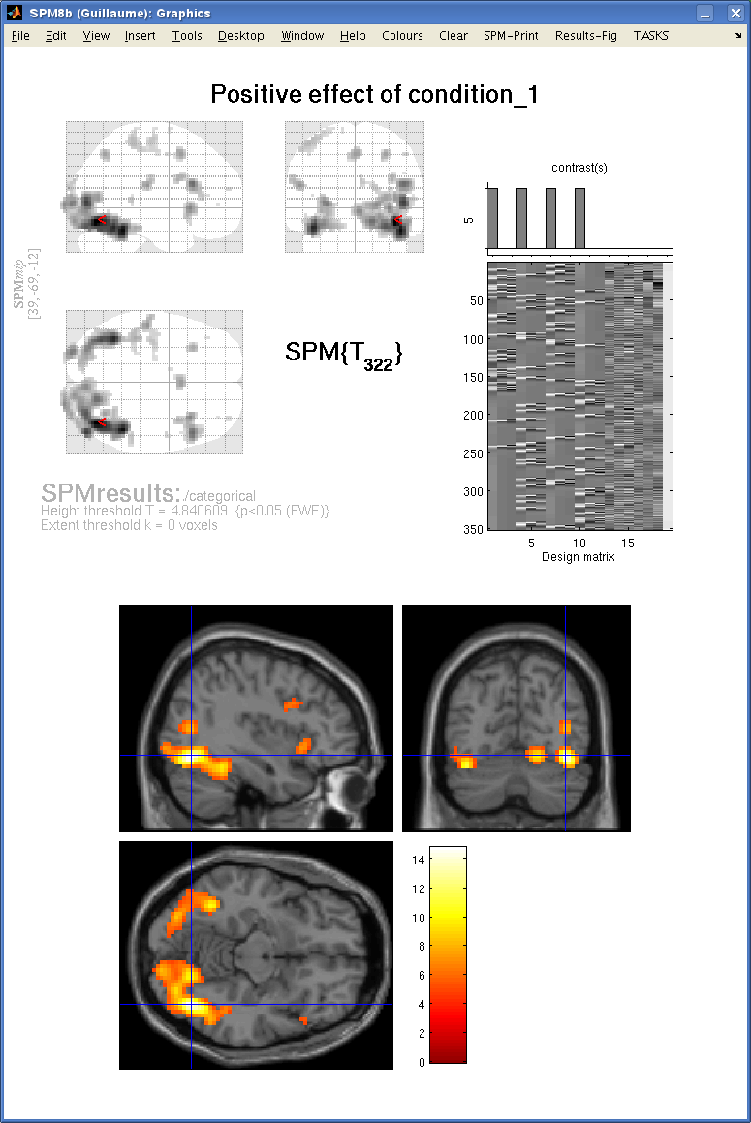
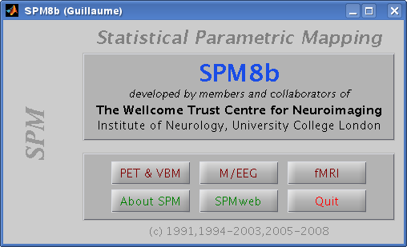
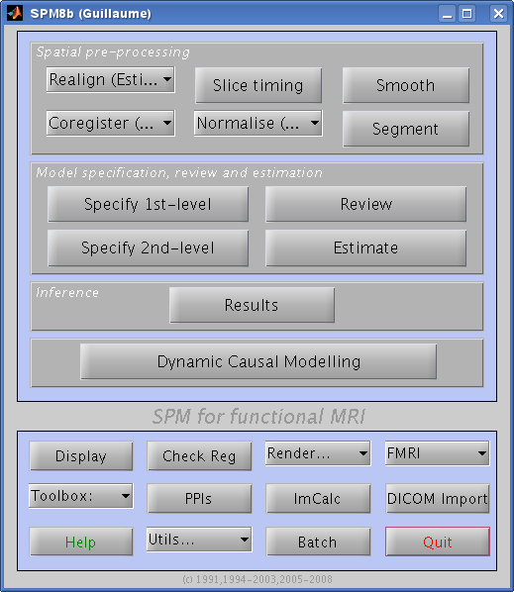
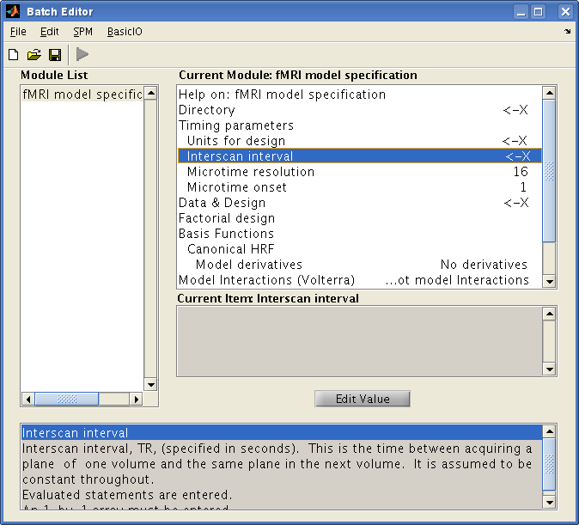
SPM Interface

Slide 6
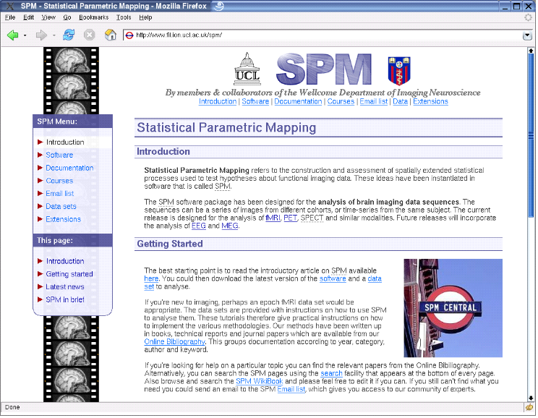
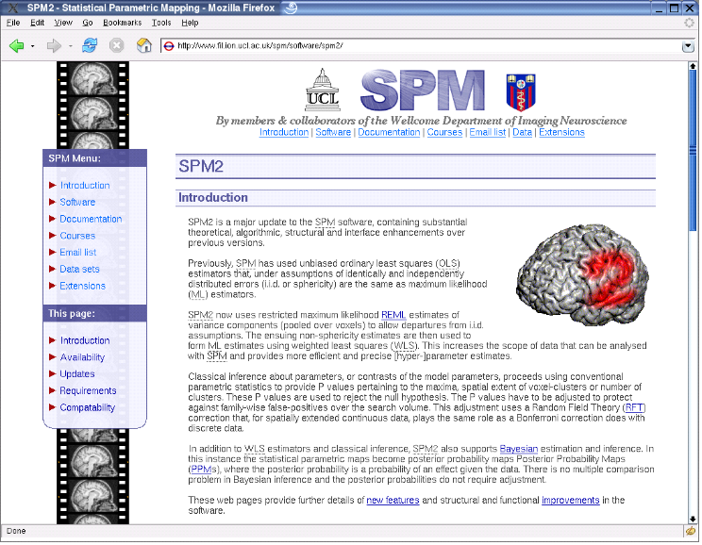

SPMweb
Introduction to SPM
SPM distribution:
SPM2, SPM5, SPM8
Documentation &
Bibliography
SPM email discussion list
SPM short course
Example data sets
SPM extensions
http://www.fil.ion.ucl.ac.uk/spm/

Slide 7
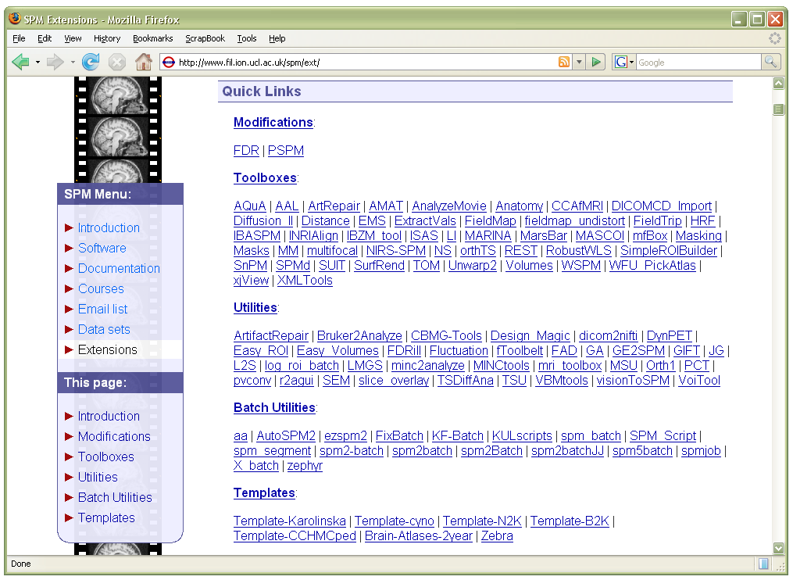
SPM Toolboxes
User-contributed SPM extensions:
http://www.fil.ion.ucl.ac.uk/spm/ext/

Slide 8
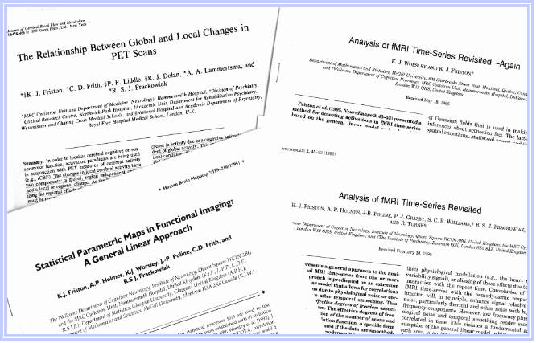
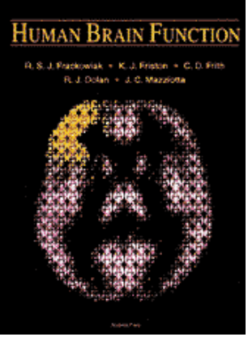


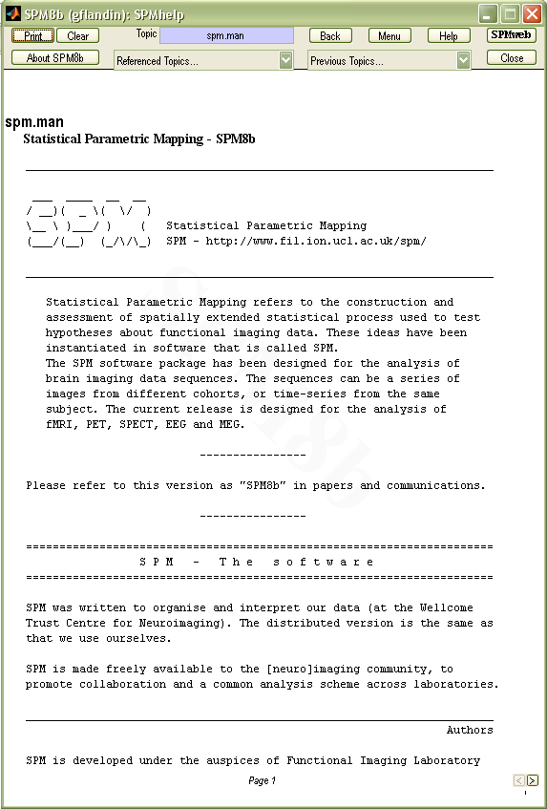
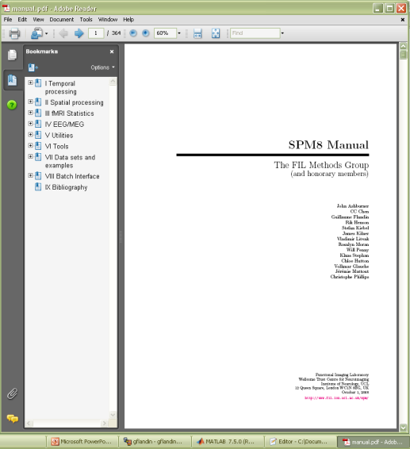
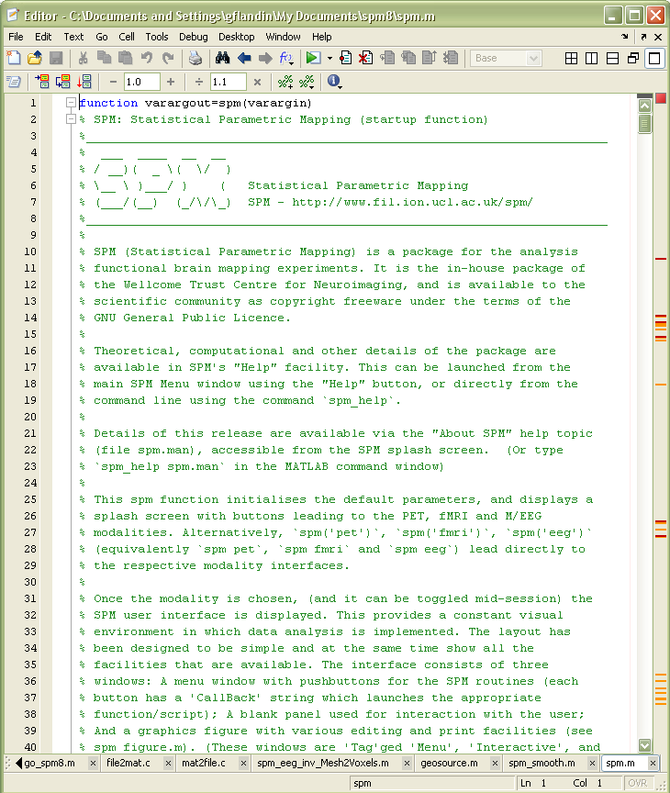
SPM Documentation
SPM Books:
Human Brain Function I & II
Statistical Parametric Mapping
Peer reviewed literature
Online help
& function
descriptions
SPM Manual

Slide 9
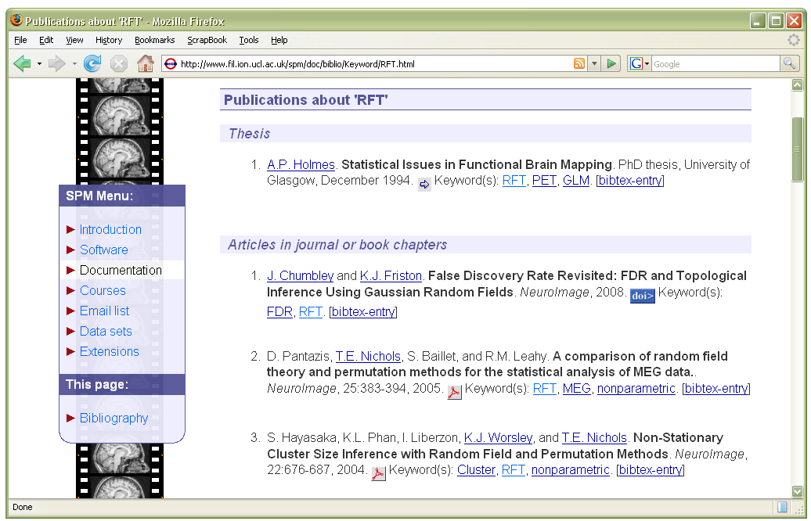
SPM Online Bibliography

Slide 10



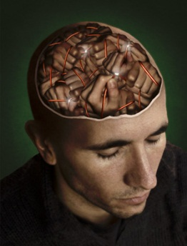
External Resources
SPM @ Wikipedia
  http://en.wikipedia.org/wiki/Statistical_parametric_mapping
SPM @ Scholarpedia
  http://www.scholarpedia.org/article/SPM
SPM @ WikiBooks
http://en.wikibooks.org/wiki/SPM
MRC-CBU Imaging/MEG wiki
  http://imaging.mrc-cbu.cam.ac.uk/imaging/CbuImaging
  http://imaging.mrc-cbu.cam.ac.uk/meg
SPM @ NITRC
  http://www.nitrc.org/projects/spm/

Slide 11
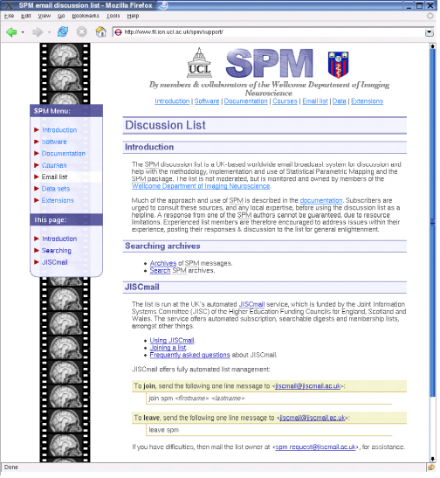
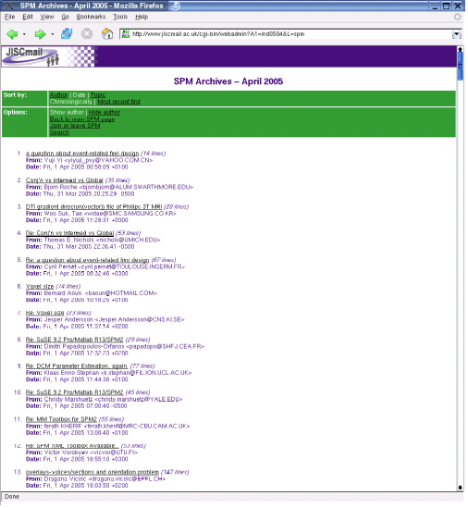
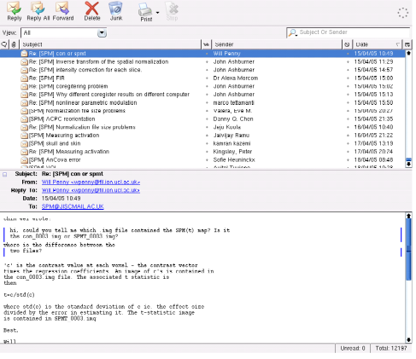
SPM Mailing List
spm@jiscmail.ac.uk
Web home page
  http://www.fil.ion.ucl.ac.uk/spm/support/
  Archives, archive searches, instructions
Subscribe
  http://www.jiscmail.ac.uk/
  email jiscmail@jiscmail.ac.uk
  join spm Firstname Lastname
Participate & learn
  email spm@jiscmail.ac.uk
  Monitored by SPMauthors
  Usage queries, theoretical discussions,
  bug reports, patches, techniques, &c…
http://www.fil.ion.ucl.ac.uk/spm/support/
spm@jiscmail.ac.uk

